Slide 1
Computer mouse replication with gestures
Team Members:
Nina, Vikram, Hidai, Vasco, Gurel

Slide 2
Project Overview
This project is focused on replicating the movements of a traditional mouse using a sensortile and a python package called PYAUTOGUI.
The inspiration for this project was the movie “Minority Report”, specifically the scene where Tom Cruise is using hand gestures to control the display.
We are going to reuse parts of the code from the tutorials and modify it to create and open a port to submit data as we move the sensor. More clearly, it’ll be passing the data to a python script. We will try and capture different movements for the mouse. We will try to at the minimum replicate all the movement classes that the PYAUTOGUI package captures.
The motivation for this project is that you can integrate this with any device or display so instead of having to manually select options you can do so via gestures, in other words touch might be augmented or substituted by motion. It could later on be modified to work for people with disabilities or ones who have suffered an injury to their fingers or arms, and allow them to use this as a headband (or similar device) to control the mouse/cursor movement.
Additionally, this would also be a better option for interaction in a VR or AR world.

Slide 3
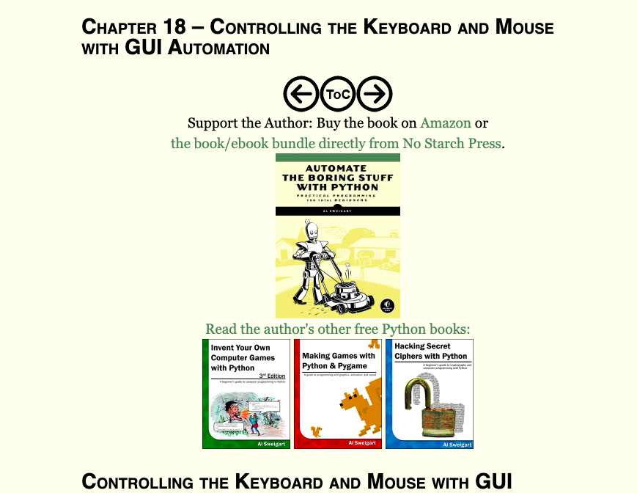
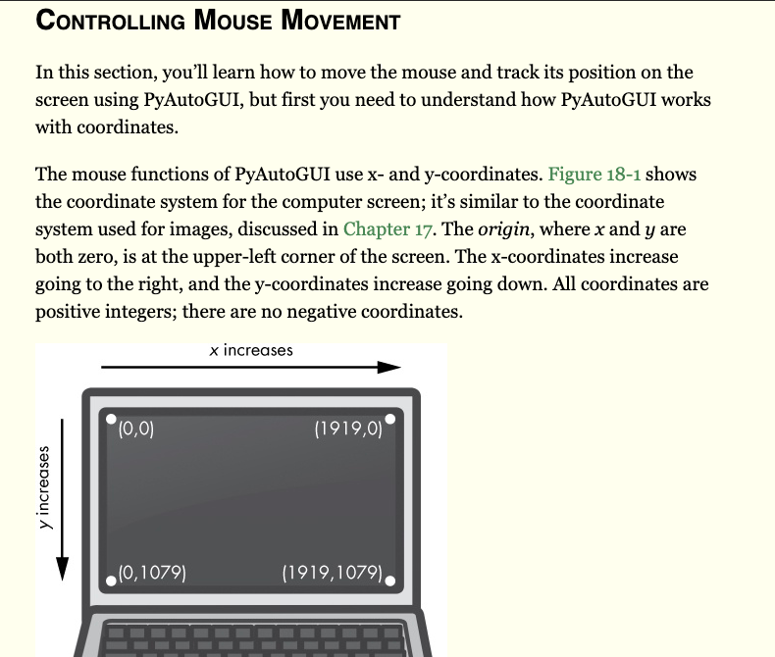
Technical Stack (Software)
We are hoping to use libUSB1 library in python to transfer the data from the sensortile to the script
There is a package in python called “PYAUTOGUI” that allows you to control the position of the mouse, which means that once the python application receives the information it can identify changes in the data and correlate those to the mouse position.

Slide 4
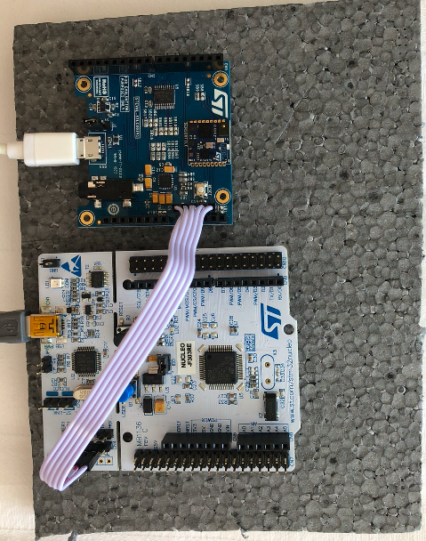
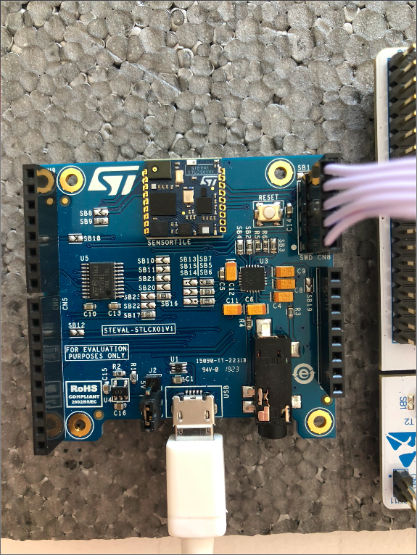
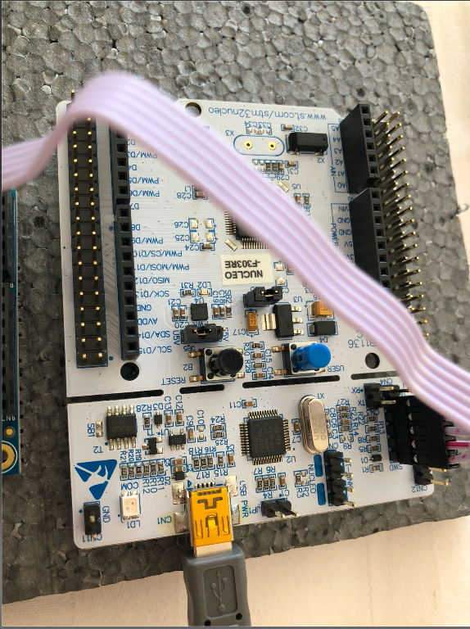
Technical Stack (Hardware)
We are using the sensortile to collect the data
Possible use of our phones

Slide 5
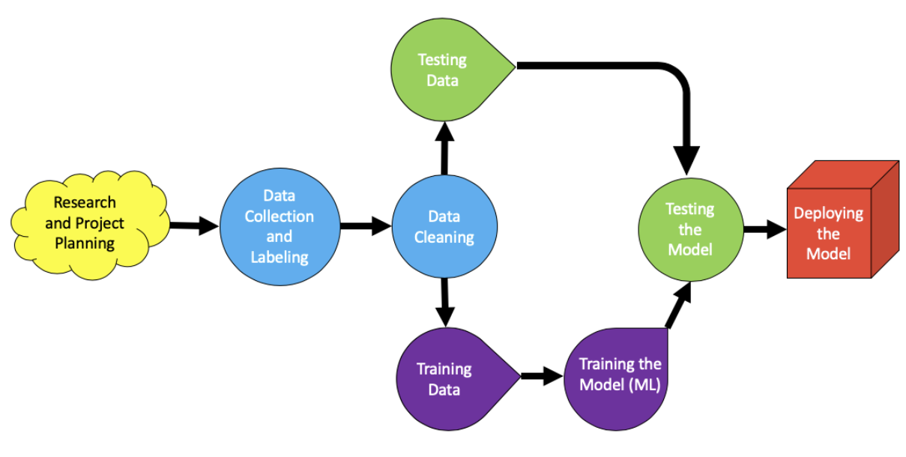
Workflow

Slide 6
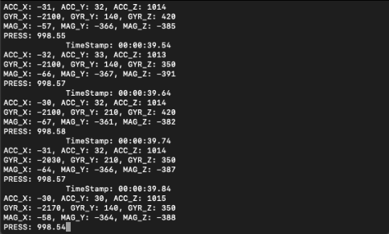
Data Collection
To collect the data, we first had to investigate the “PYAUTOGUI” package to determine the movements and get an idea of how we could compile the code. After some investigation, we decided to use 6 motions, each mapped to a certain movement of the mouse or a click.
For each movement, we decided it would be best to use 75% of the data for training and 25% of the data for testing. To do that, we decided to collect data 30 times for each of the gestures, totaling 180 collections. To add variety to our gestures, we decided to use different speeds for the movements: fast, medium, and slow.
After collecting each data, we labeled them according to their speeds and their types. Finally, we uploaded them to our GitHub repository to proceed with data processing.

Slide 7
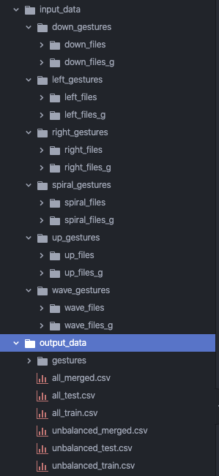
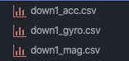
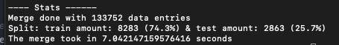
Data merging, concatenation and cleaning
Seperate Project
Data collection from 2 team members
Merged each indexed movement sensors files into 1
Concatenated per movement type
Equal amount of each person in test/train
Cutoff was around 25/70 because 15 recordings per movement, so 11/4
Drop irrelevant columns
Drop null rows
Remaining of columns

Slide 8
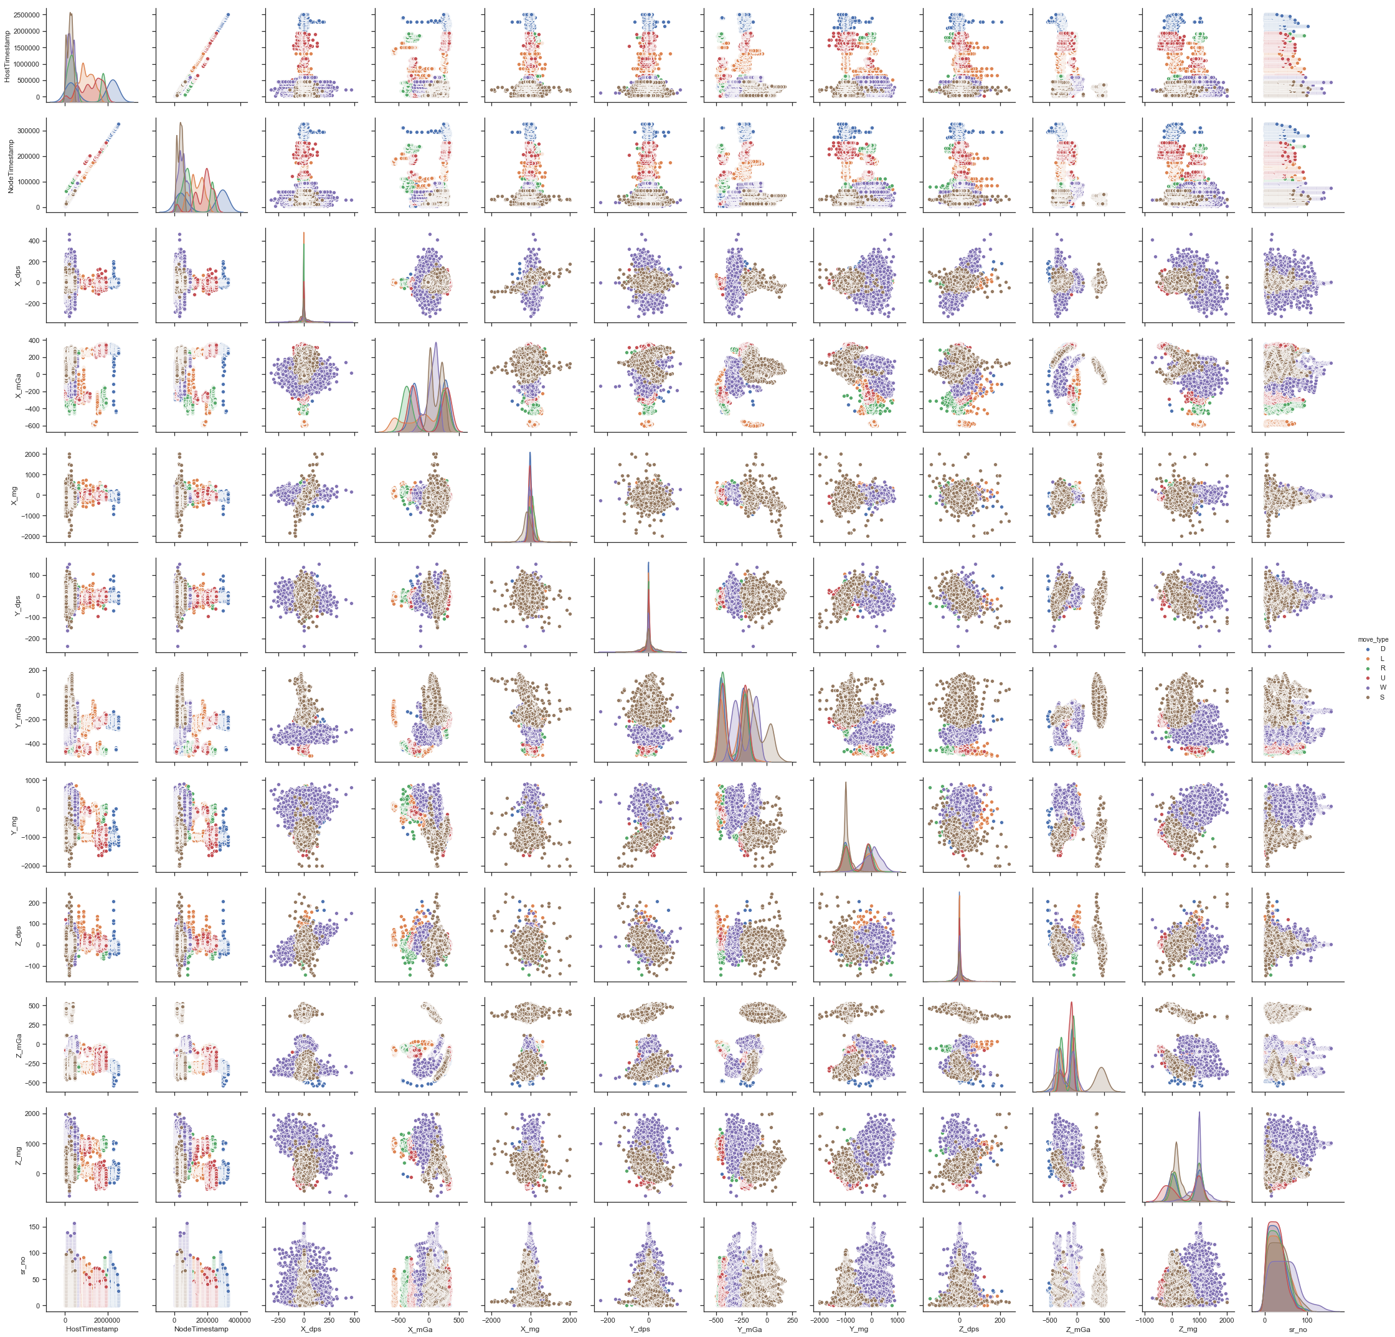
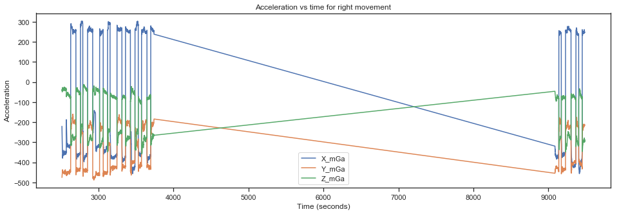
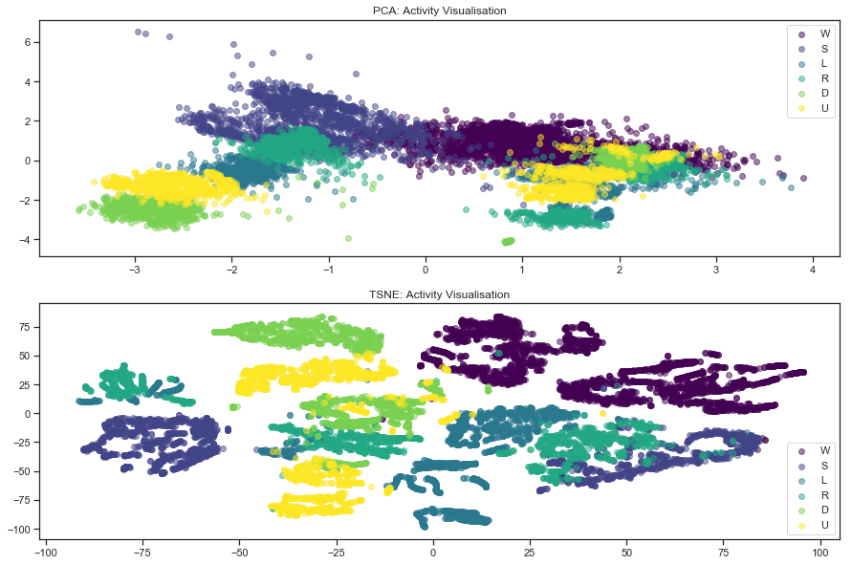
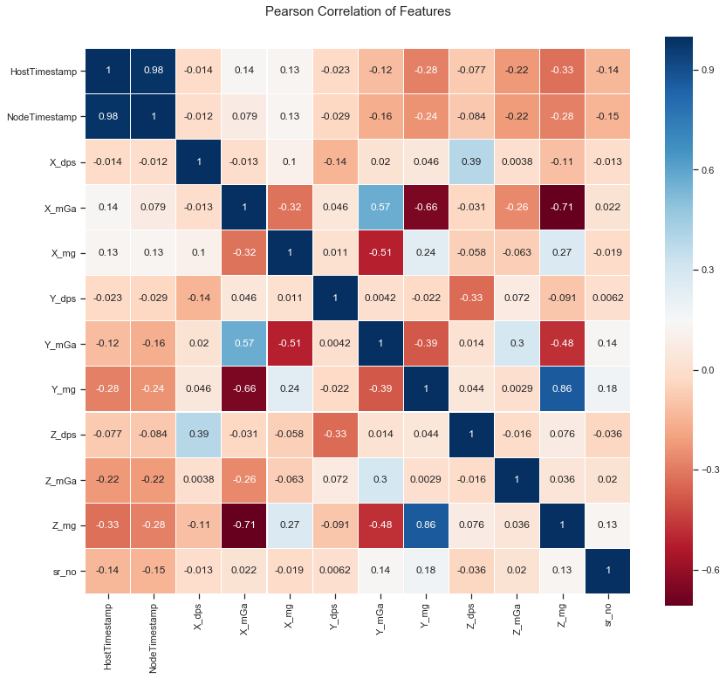
Machine Learning: Model Training, Evaluation & Optimization
Methodology
Step 1. Environment Setup
Step 2. Data Setup
Step 3. Exploratory Data Analysis
Step 4. Classifier Model Training & Evaluate Models
Model 1:Logistic Regression
Model 2: SVM
Model 3:Random Forest
Model 4: AdaBoost
Model 5: XGBoost
Step 5. Best Model Selection
Step 6. Hyper Parameter Tuning Of Selected Model
Step 7. Save Persistent Finalized Model to Disk

Slide 9
Machine Learning: Summary Results
Performance metrics used:
Accuracy
Precision
Recall
Prediction execution time
Winner: XGBoost selected as the best performing model
(Accuracy >85%, Precision>85% , Recall>80% , Predication execution time <0.05 sec)

Slide 10
Final Product
The goal of this project was to create a script that would react to the movement of the sensor tile in real time and move the mouse cursor accordingly on the screen.
In order to accomplish this task, the first thing we did was to investigate different machine learning algorithms so that we could differentiate and associate gestures with sensor tile readings.
This was done through visualization, feature importance, and dimensionality reduction techniques. We further investigated the accuracy of a variety of classification techniques, determining that XGBoost resulted in high quality classifications.
We then created a real time system incorporating C and Python in order to process sensor movements in real time, these sensor readings were then converted into actualized corresponding mouse movements on the screen.
Therefore this project demonstrated and serves as a proof of concept on the feasibility of controlling the computer mouse through wearable sensors.
We expect this type of technology could be of great interest and benefit for controlling computers remotely without the use of traditional input devices like keyboard and mouse as it’s usually the case in AR and VR environments.

Slide 11
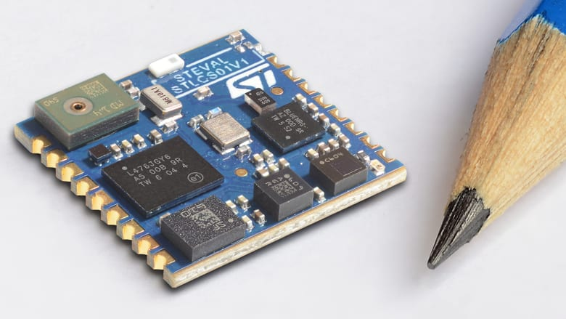
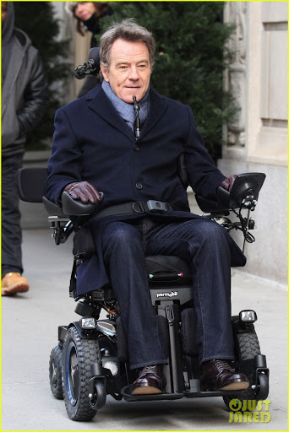
Next Steps and Future Plans
With further development, this technology could be useful for people with disabilities. For example, a paralyzed person could rotate his head to control the direction of his wheelchair. A hat containing a sensor or even glasses with an embedded sensor could be used to control the wheelchair. The chair can be programmed to register the voice commands of the user as starting and stopping the motor and while in action, the user can tilt his head the direction he wants to go. The chair could register this swiping motion and redirect the user in the direction he wants to go. The sensor integration could be taken even one step further with nanochips in the future by embedding the actual sensor inside the eye so that no external sensor is needed to control the chair. Just the eye movements of the user would suffice to control the cart if used this way.

Slide 12
Web App Classification
Live demo of our ML classifier by means of a Web App
How it can be build:
Django > 3.0 Backend
Support ASGI, asynchronous python code
So support of websockets is build in
React Frontend
Link the react app with the django project
Simple page to handle UI and display results
Bridge React App with js Generic Sensor API
ML Integration
Implementing our model in the Django backend
Which classifies movements based on sensors from the front end

